Slide 1
Uber Data Analysis
Data Visualization
Jerin Easo Thomas (jerithom@iu.edu),
Sarthak Vivek Chawathe (schawat@iu.edu)
Indiana University

Slide 2

Introduction & Motivation
Digital Age and Urban Transportation
Rising Demand for Data-Driven Solution
Our Motivation:
Understanding user behavior
Contributing to urban mobility
Commitment to Innovation

Slide 3

Abstract Overview
Study Scope:
Analysis Period: April to September 2014.
Focus: Uber's operational data in New York City.
Objective: To transform urban mobility through data-driven insights.
Key Methodologies:
Advanced Analytics and Visualizations.
Temporal Granularity: In-depth analysis of time-based patterns.
Dynamic Geospatial Profiling: Examining spatial patterns in service demand.
K-Means Clustering for Predictive Modeling: Utilizing historical pickup data to optimize service delivery.
Primary Contributions:
Ethical Data Use: Prioritizing user privacy and responsible data practices.
User-Centric Visualizations: Enhancing stakeholder understanding through intuitive and interactive visuals.
Novel Insights: Revealing subtle shifts in user behavior and demand patterns.

Slide 4
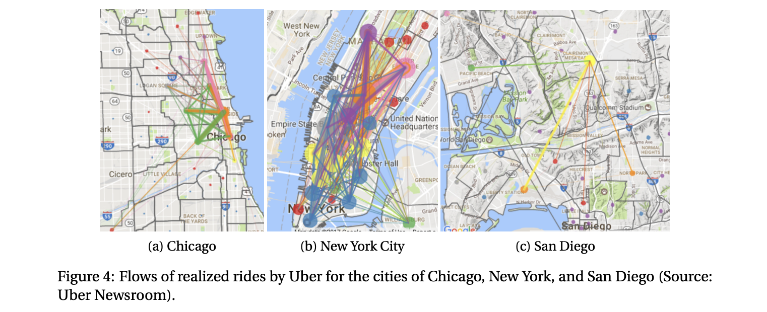
Review of Existing Work
1. Temporal Dynamics in Ride Sharing
Study: Smith et al., “Temporal Patterns in Ride-Sharing Preferences” (2019)
Analysis: Smith et al.'s research illuminated the dynamic nature of user preferences over time, showcasing how temporal factors influence uber ride habits. Their visualizations meticulously depicted hourly and daily fluctuations in ride requests, laying the foundation for our temporal analysis.
Discussion: This study is pivotal as it prompts us to consider the temporal dimension in our analysis. By understanding when users are most active, we can optimize service availability and anticipate peak demand periods.

Slide 5
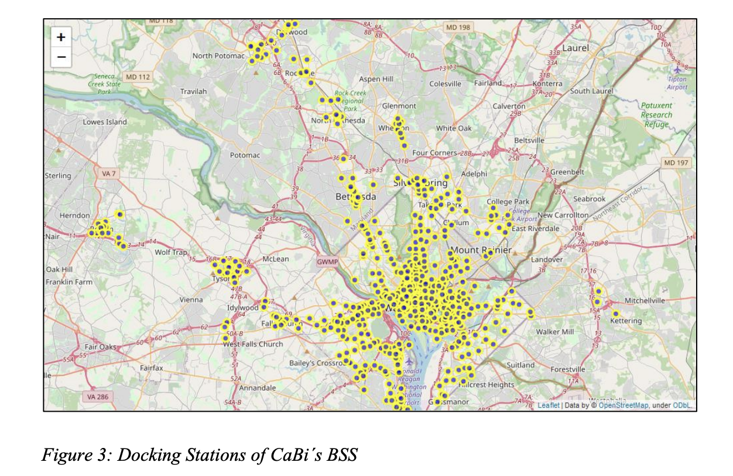
Review of Existing Work (Continue)
2. Geospatial Analysis of User Behavior
Study: Johnson and Rodriguez, “Mapping the Ride: Geospatial Analysis of Ride-Sharing Choices” (2020)
Analysis: Johnson and Rodriguez delved into the geographical nuances of ride-sharing preferences, revealing distinct patterns in urban and suburban areas. Their visualizations provided insights into how location influences user behavior.
Discussion: Incorporating geospatial insights is crucial in our analysis, especially in understanding the varied demands and preferences across different regions. This study guides us in optimizing service deployment based on location.

Slide 6
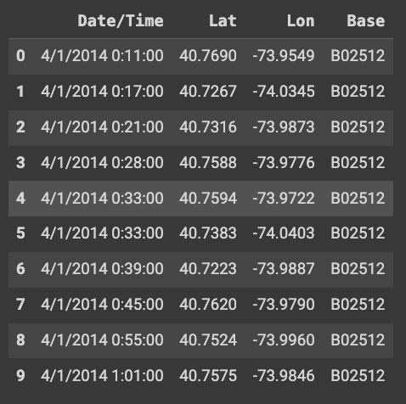
Dataset Overview
There are six csv files of raw data on Uber pickups in New York City from April to September 2014.
The files are separated by month and each has the following columns:
Date/Time : The date and time of the Uber pickup
Lat : The latitude of the Uber pickup
Lon : The longitude of the Uber pickup
Base : The TLC base company code affiliated with the Uber pickup
No of Rows: 4.5M

Slide 7

Data Analysis and Visualization Methods
Monthly and Daily Trip Distribution
Hourly Ride Frequency
Day Wise Trip Distribution
Base Location Analysis
Heatmap of Weekday and Hourly patterns
Peaks and Pits Analysis
Geographical Heatmaps
Neighborhood Analysis
Predictive Modelling

Slide 8
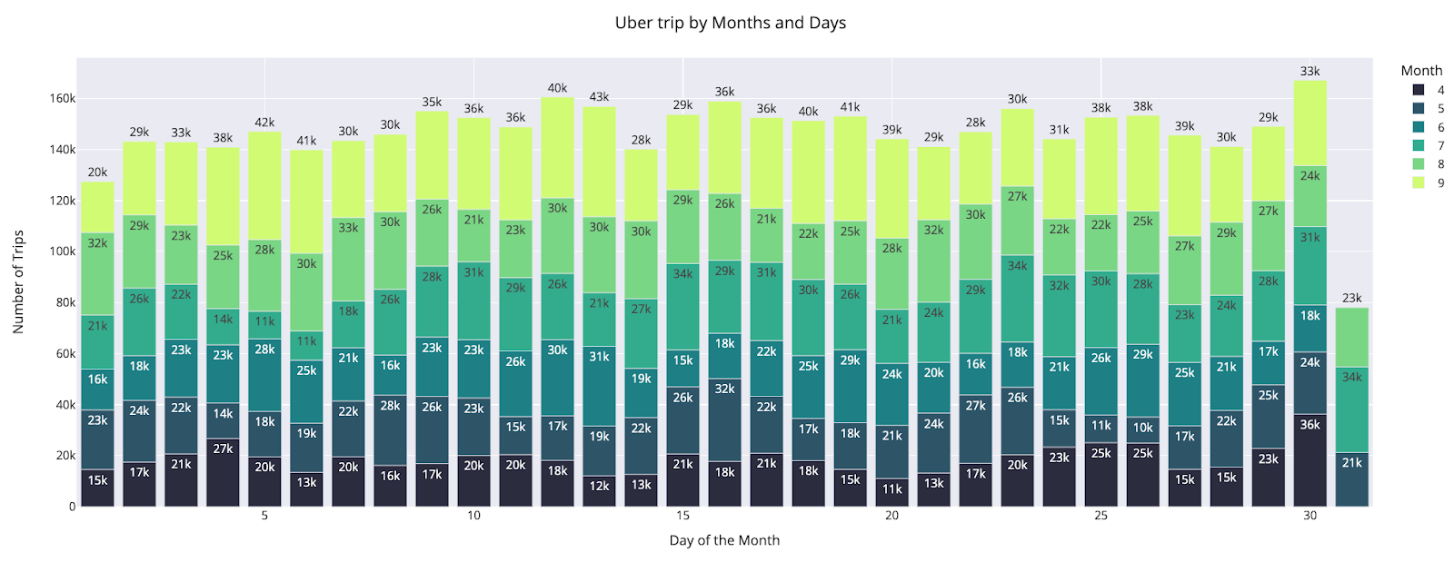
Data Analysis & Visualizations
Part 1: Exploratory Data Analysis
Which day of the month and which month has the most Uber trips?

Slide 9
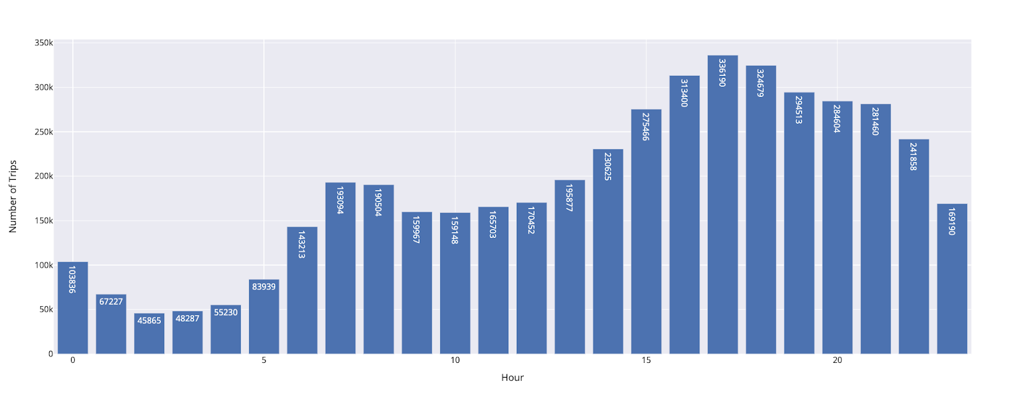
Part 1: Exploratory Data Analysis (Continue)
Which time of day is the busiest for Uber cabs?

Slide 10

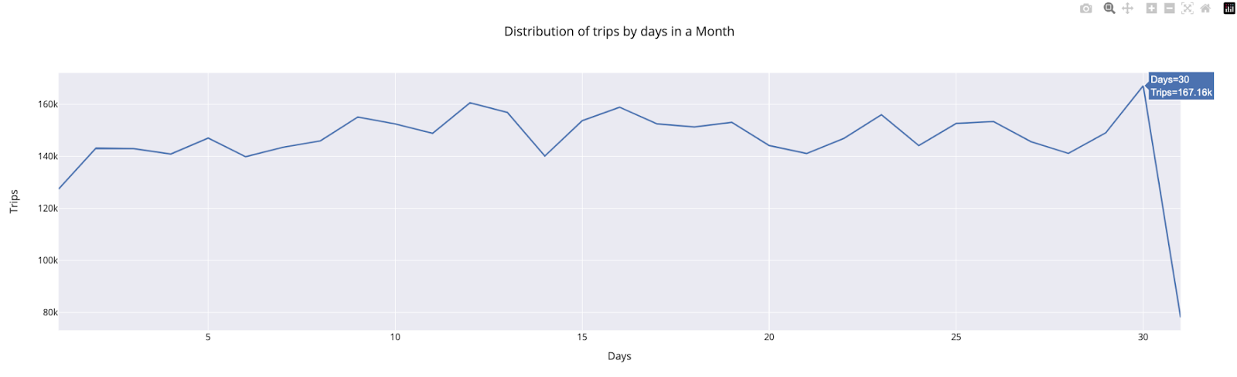
Part 1: Exploratory Data Analysis (Continue)
What is the breakdown of trips by day over the course of six months combined?

Slide 11
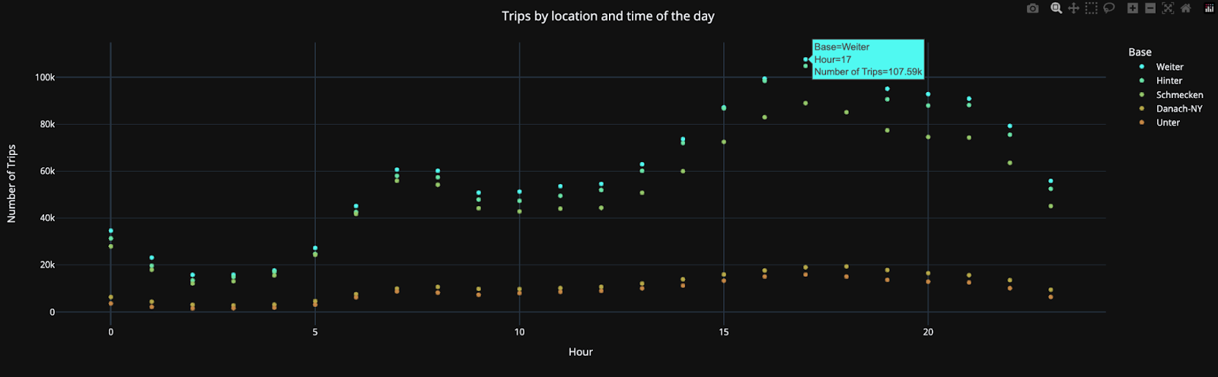
Part 1: Exploratory Data Analysis (Continue)
Base locations with the most number of pickups?

Slide 12
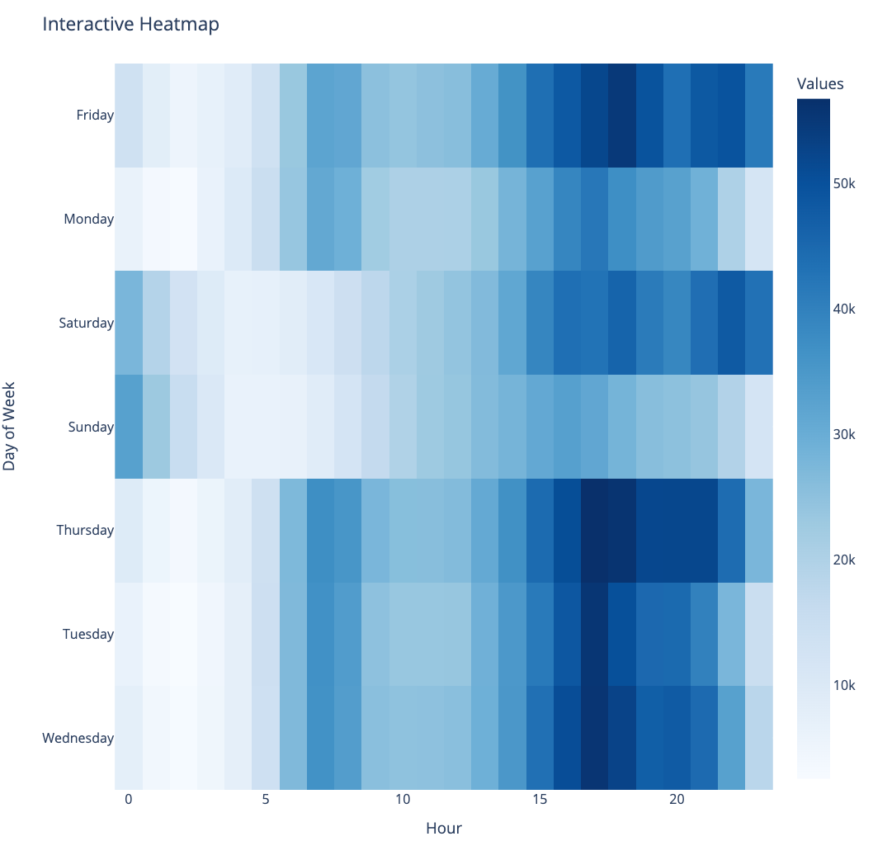
Part 1: Exploratory Data Analysis (Continue)
Connection between the number of trips, the hour, and the day of the week?

Slide 13
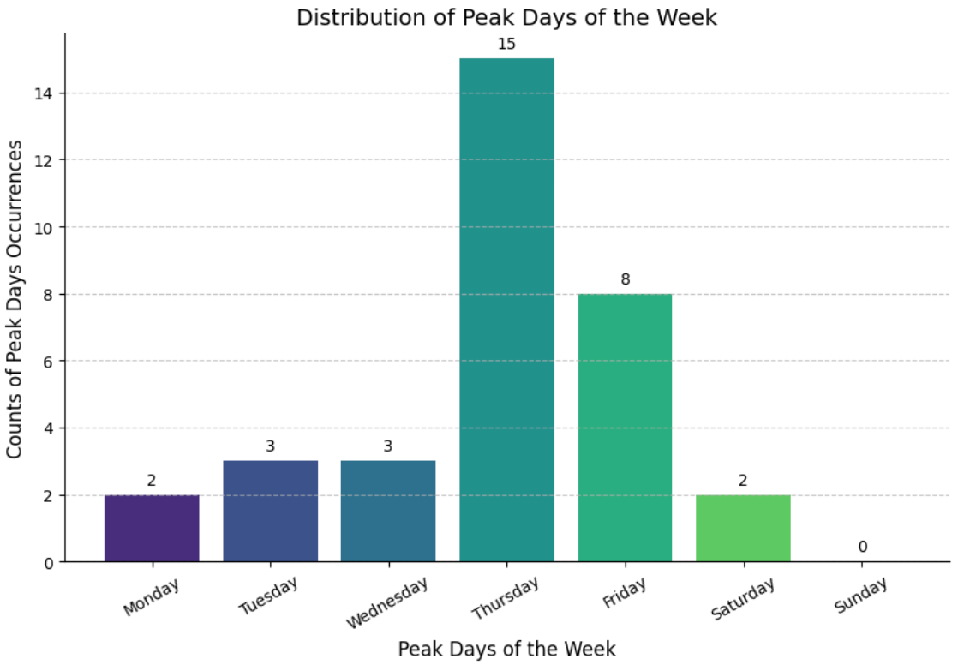
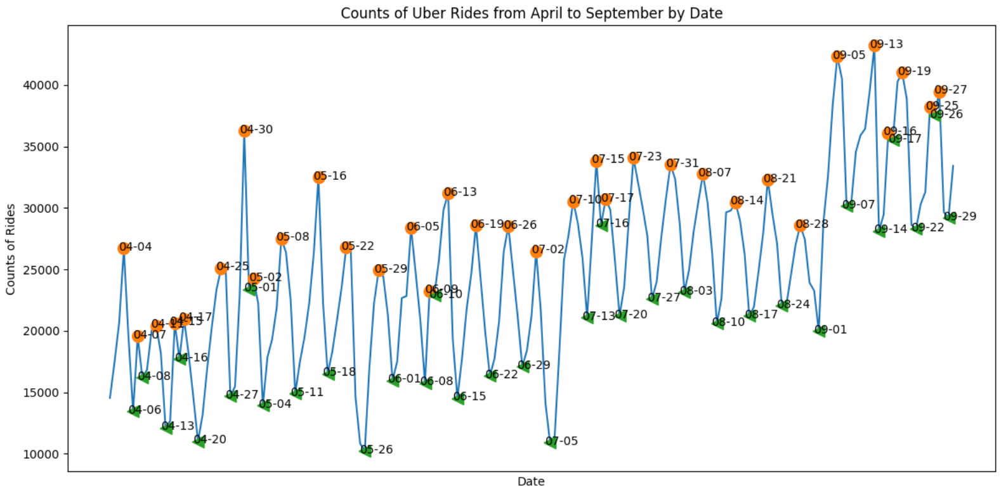
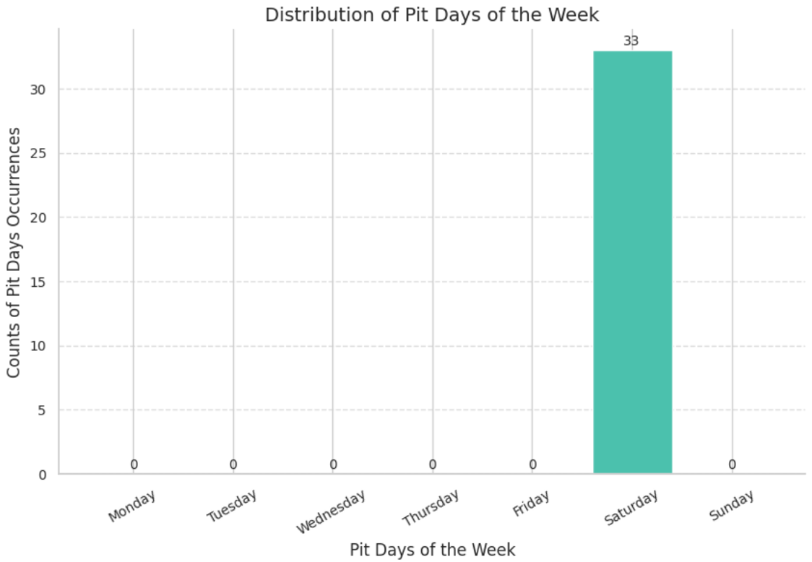
Part 1: Exploratory Data Analysis (Continue)
Does the data include peaks and pits?

Slide 14
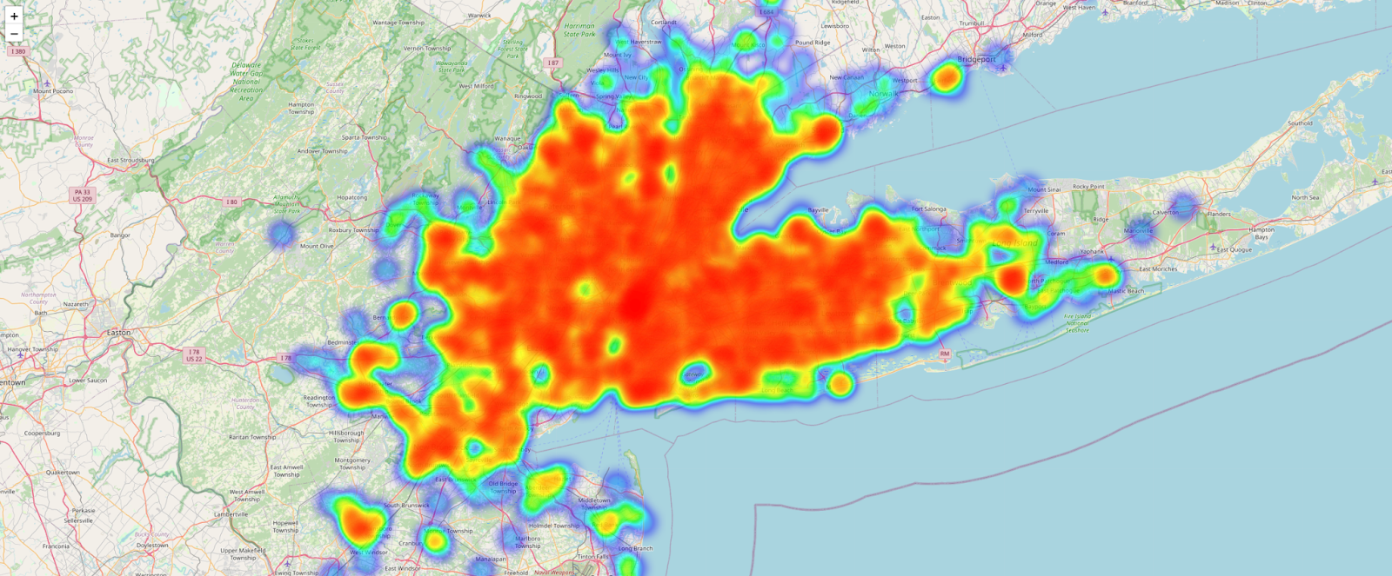
Part 1: Exploratory Data Analysis (Continue)
Does the data include peaks and pits?
Uber Ride Patterns in NYC: A Heatmap Analysis to Verify Proposal
HeatMap for Thursday

Slide 15
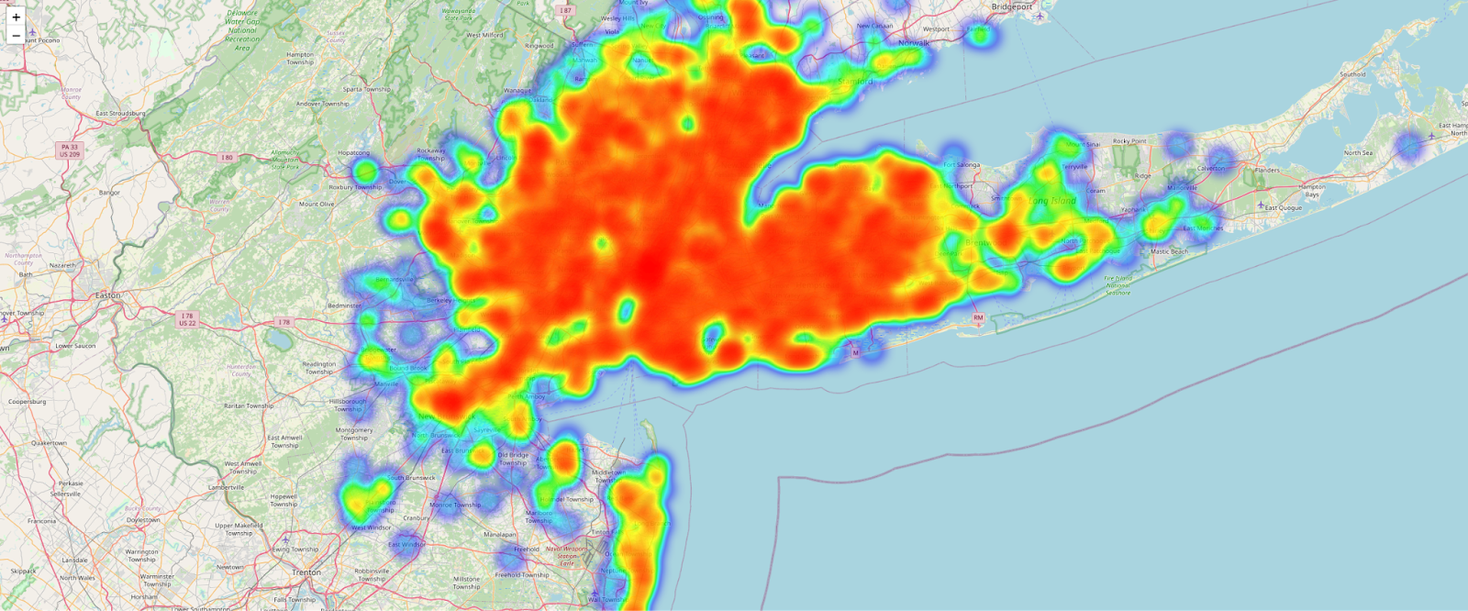
Part 1: Exploratory Data Analysis (Continue)
Does the data include peaks and pits?
Uber Ride Patterns in NYC: A Heatmap Analysis to Verify Proposal
HeatMap for Sunday

Slide 16
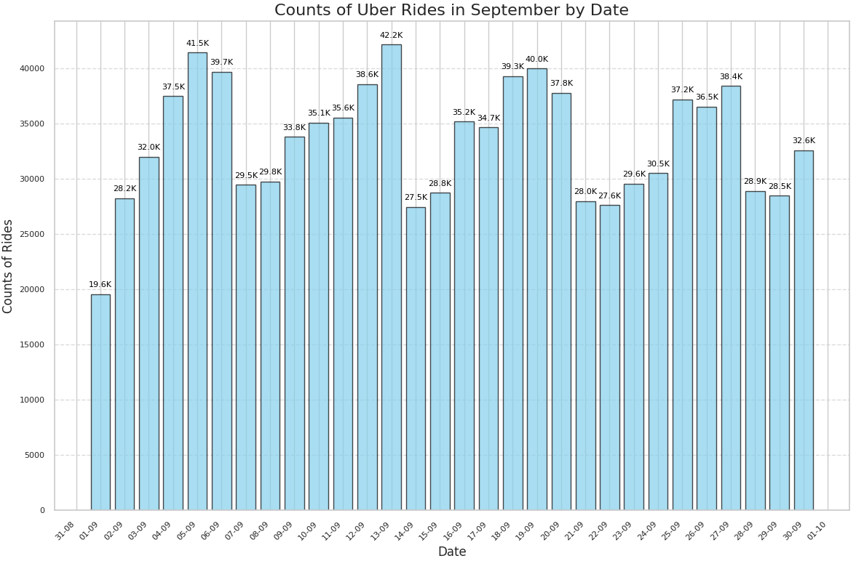
Part 1: Exploratory Data Analysis (Continue)
Any insights from the month that had the most rides?

Slide 17
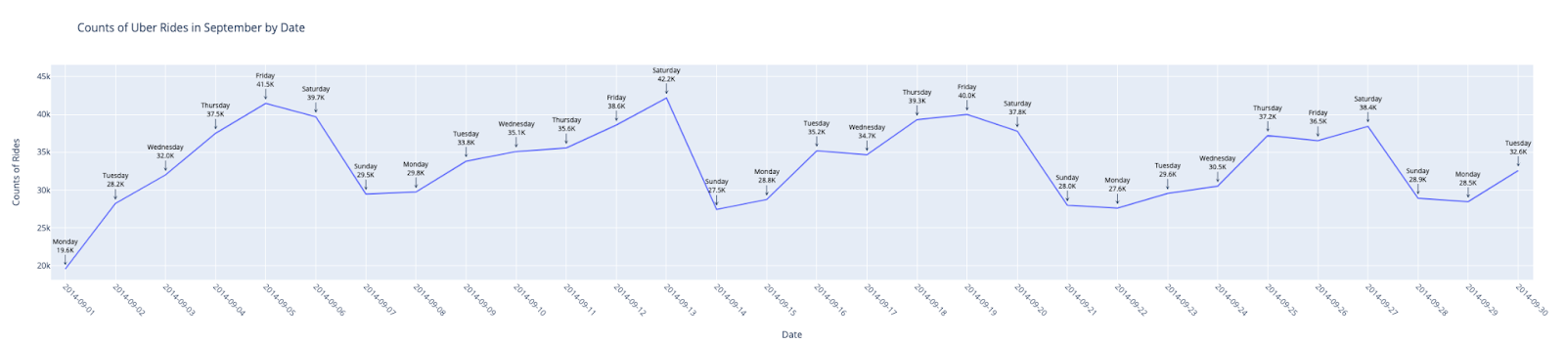
Part 1: Exploratory Data Analysis (Continue)
Any insights from the month that had the most rides?

Slide 18
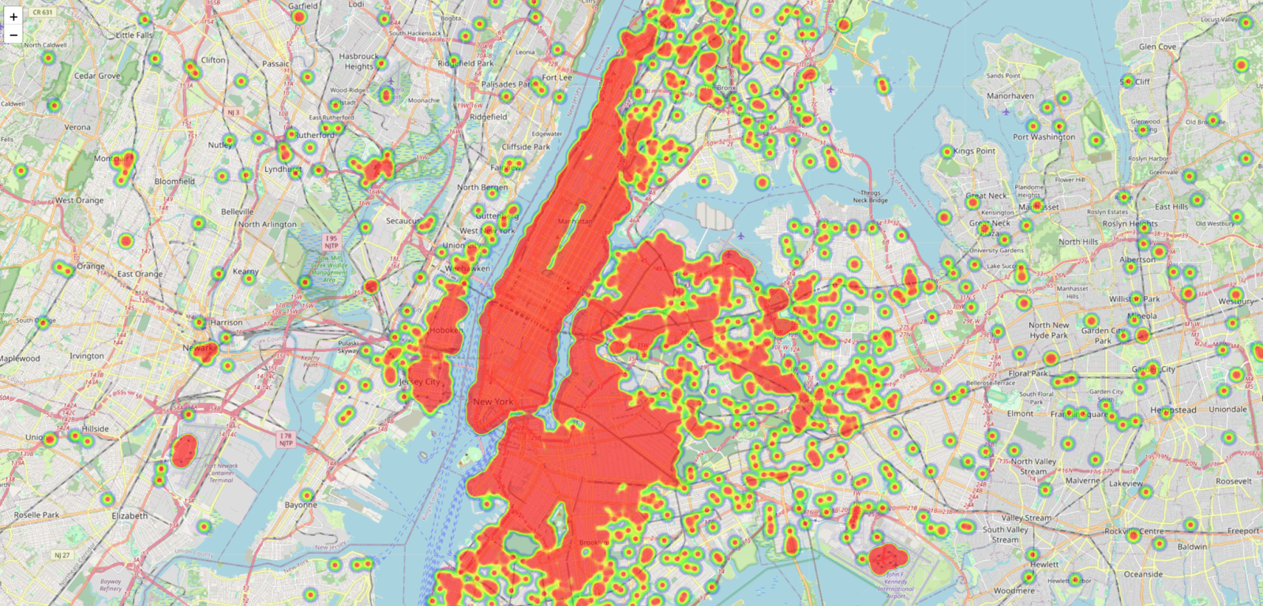
Part 1: Exploratory Data Analysis (Continue)
September geospatial analysis
Animation Link: file: https://drive.google.com/file/d/1U4SPwHNJACPKqGKzQ2gCsN7H4FznigN7/view?usp=sharing
Animation Snip

Slide 19
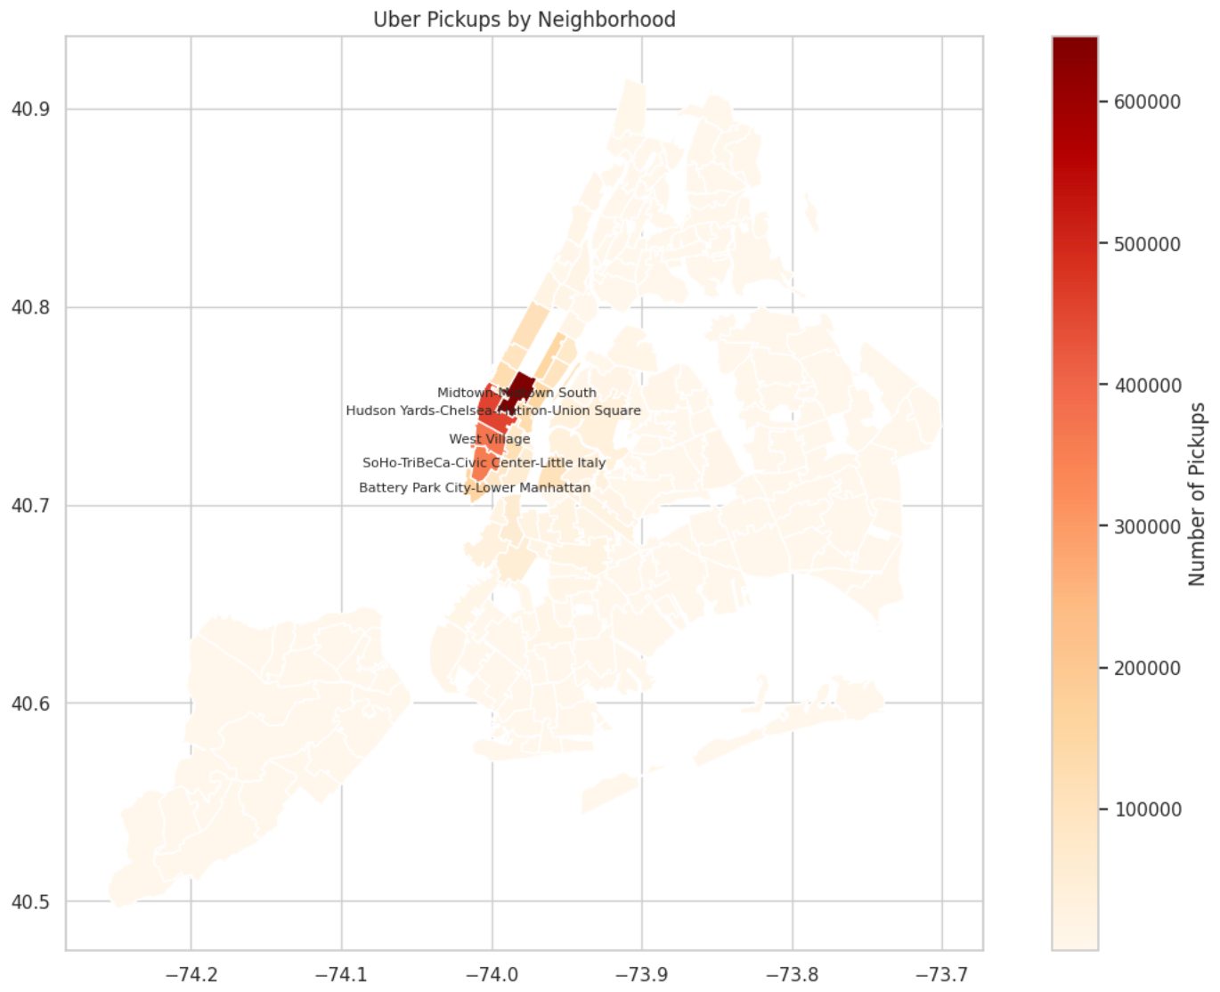
Part 1: Exploratory Data Analysis (Continue)
Neighborhood Analysis
Top five Neighborhood with most pickups.

Slide 20
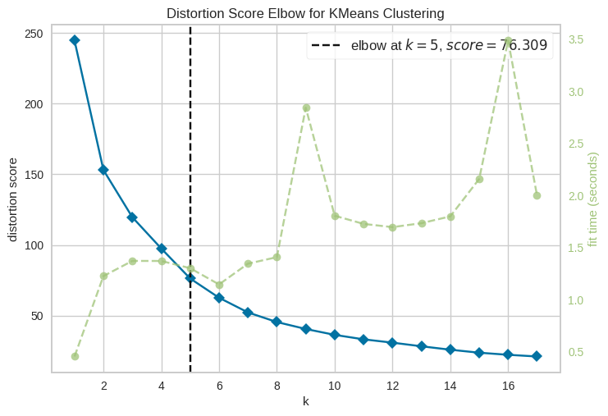
Part 2: Predictive Modeling And Dashboard
KMeans Clustering
Preparing the Data
- Latitude & Longitude
Finding the Sweet spot for clusters
- How many clusters should we create?
Understanding the elbow method
Result for the stakeholders
Finding the good balance between the number of clusters and accuracy of the model.
Bottom line

Slide 21
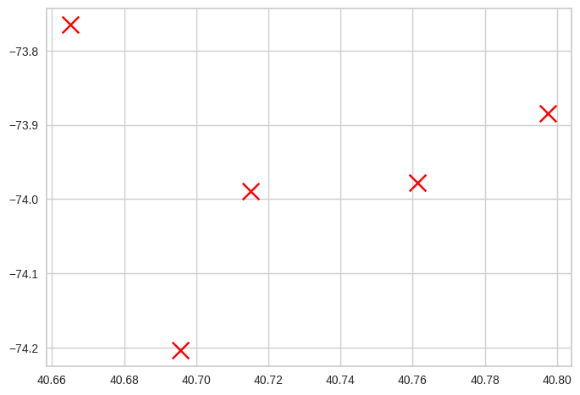
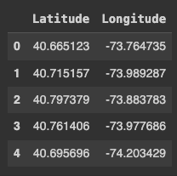
Part 2: Predictive Modeling And Dashboard (Continue)
Challenges faced while performing Kmeans & Outcomes

Slide 22
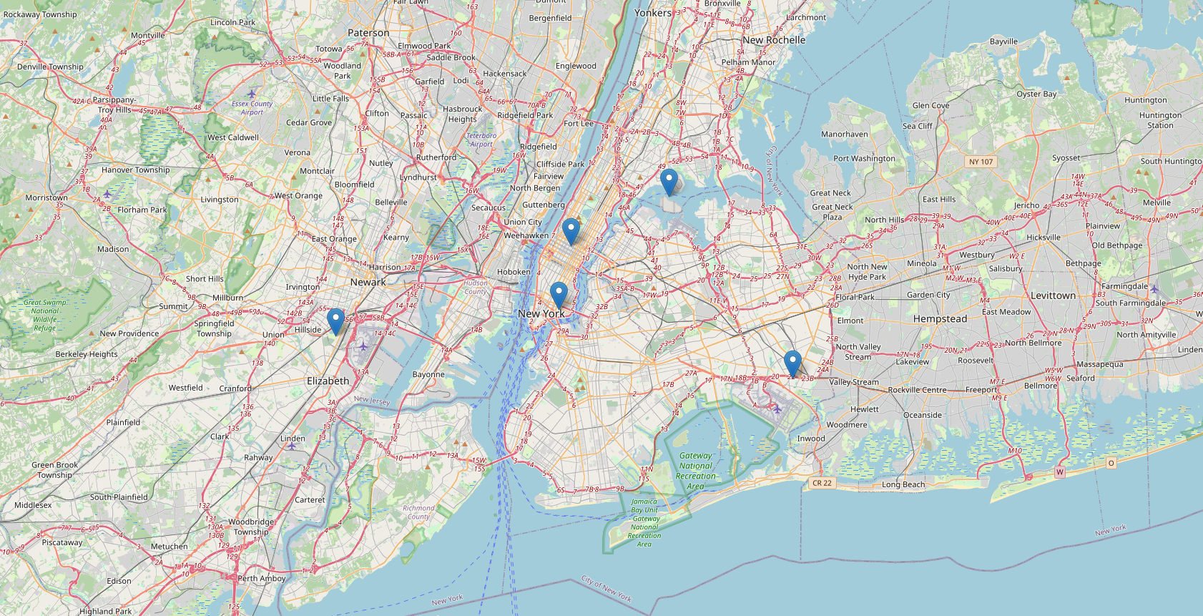
Part 2: Predictive Modeling And Dashboard (Continue)
A step beyond just 2-D scatter plot
link : https://drive.google.com/file/d/1BxL_36U0ARZ86c2rc_bV0ucfbDqSMpvV/view?usp=sharing

Slide 23
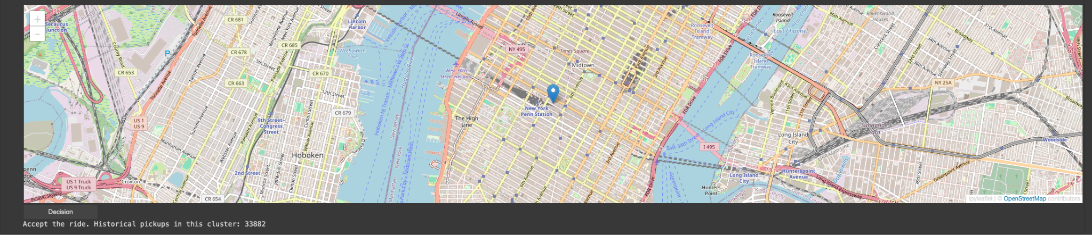
Part 2: Predictive Modeling And Dashboard (Continue)
Decision Making Time

Slide 24

Future work
Temporal Dynamics Refinement
Enhanced Geospatial Insights
Predictive Modeling Evolution
User-Centric Decision Tools
Advanced Authentication Mechanism
Incorporate Multi-Factor Analysis
Real-Time Dashboard Development
Collaborative Research Initiatives
Continuous User Engagement

Slide 25
Conclusion
Explore Uber's NYC data for insights into user behavior, temporal dynamics, and geospatial patterns.
Utilize advanced analytics, including K-Means clustering, to optimize service delivery.
Future scope involves refining decision tools, embracing cutting-edge technologies, and contributing to urban planning discussions.
This project is a commitment to shaping a future where Uber-ride is efficient, user-centric, and sustainable using the visualizations provided.

Slide 26
Thank you!

